Slide 1
Health Canada’s Proposed Pediatric Drug Action Plan: Insights and Feedback
as part of MICRYRN’s Webinar Series
February 3, 2021

Slide 2
Agenda
10:00am Welcome and Introduction to Panelists
Andrea Gilpin, GPFC
10:05am Alysha Croker
Office of Pediatrics and Patient Involvement
Health Canada
10:25am Catherine Litalien, GPFC
Summary of Results from Survey
10:55am Polling Questions to Audience
Charlotte Moore-Hepburn, CPS
Questions and Answer Period
Andrea Gilpin, GPFC
11:30am Conclusion of Workshop

Slide 3
Background to Survey
2020-21
2014
During the Canadian Society for Pharmaceutical Sciences in November 2020, Health Canada presented a new Pediatric Drug Action Plan (PDAP).
The GPFC and MICYRN wanted to provide feedback on the PDAP to Health Canada from the pediatric community and therefore organized this workshop.
In preparation for this workshop, the GPFC has sent a survey to gain comments and feedback on the proposed PDAP.
Focus of this session is on PDAP, with the exception of Clinical Trials issues, as MICYRN led a clinical trial workshop in January.
2019

Slide 4
Alysha Croker Office of Pediatrics and Patient Involvement
Overview of proposed Pediatric Drug Action Plan by Health Canada

Slide 5
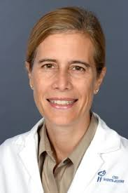
Catherine Litalien, Co-Founder of GPFC and Pediatrician
Summary of Survey results conducted by the Goodman Pediatric Formulations Centre.

Slide 6
Methodology
The survey was conducted using Google Forms
The questionnaire (8 questions) was sent to over 25 people representing over 19 organizations with the encouragement to share the survey with others in the pediatric community
January 8-18, 2021
26 surveys were completed representing over 30 people (some people did one survey but were two people)
16 organizations responded
Subject matter experts
Academic institutions/universities
Pediatric Associations
Physicians/Clinicians
Hospital Pharmacists
Pharmacists
Researchers
Geographical diversity

Slide 7
1. Was the summary of Health Canada’s “What we Heard” complete ?
Notes:
So this was the first question:

Slide 8
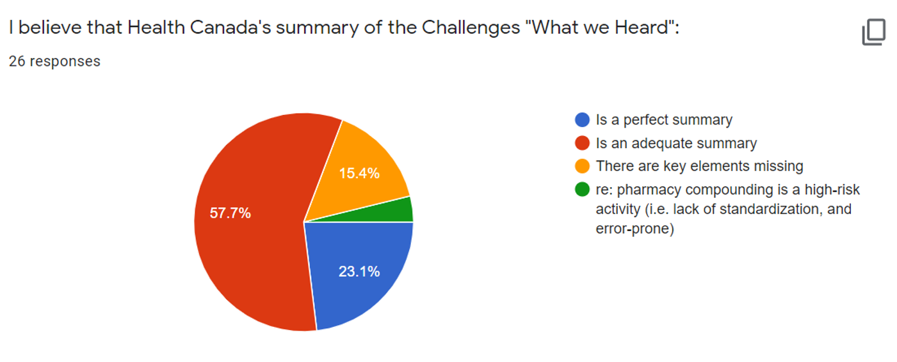
Health Canada’s “What we Heard” captured many of the key points…
Other

Slide 9
“What we Heard” Comments
Receiving pediatric data in Canada
Pediatric Clinical Trials
Economic Realities of developing pediatric medicines
Off-Label use and compounding of medicines in children
Incentives to submit pediatric data/drugs are insufficient
Older/generic drugs unlikely to submitted for new indications or formulations
Awaiting the use of Trusted Foreign Decisions
Legislation to require pediatric trials
Accept pediatric international trials
CHEER an asset
Compounding may not be as cheap as we think
Inclusion of all costs for compounding (direct & indirect)
Compounding not equivalent to commercial formulations
Rare disease framework is missing
Smaller market=attractive incentives needed
Lack of data capture from off-label use and compounding (and lack of funding)
No current standards for compounding across Canada
Access to appropriate formulations at a fair price
Transversal Key Components
Lack of Expert Pediatric Advisory Board (EPAB) at the Ministerial Level
Misalignment with market access, reimbursement, pricing and provincial listing (disincentive)
Lack of pediatric specific criteria for HTA evaluation
Lack of harmonization from PTs to prioritize pediatric drugs/formulations
Lack of clear & consistent pathways and costs for entire process

Slide 10
2. R2D2

Slide 11
Summarized Comments- Pediatric Specific
Expanded collaboration with health partners
Timely access to drugs and devices
Enhanced use of real-world evidence
Alignment of HTA review, PT listing and pricing decision with HC
Use of foreign decisions (pediatrics may have own requirements given unique needs)
Pathways to ensure rapid access to life saving pediatric medications for certain critical diseases
Inclusion of patients and HCP
Pediatric-specific considerations throughout the drug approval and market access process including provincial listing
Address provincial barriers to list
Develop process to capture extensive RWE with pediatric drug use (compounding and off-label)
Funding needed for data registries
How to engage all qualified stakeholders to report AEs (parents, HCP, pharmacists)
Modern and Flexible Operations:
Unique fee structure for ped formulations
Use of RWE in compounding medications to support commercial submissions
Clear role for OPPI in broader HC modernization efforts
Optimal positioning of OPPI within HC to bridge between regulation and clinical trial reform

Slide 12
3 PDAP Methods
CONFIDENTIAL

Slide 13
3 PDAP Methods -Comments
Health Canada is exploring ways to increase the development of essential pediatric medicines and formulations. Some potential actions include:
Developing a national priority drugs list for pediatric diseases/molecular targets (including formulations) that will guide pediatric medicine development in Canada.
Governance of committee, funding and organization – when to be established and who is leading this effort?
Recognition of list and priority by HTA and PT
Includes rare disease and formulations
Developing incentive models for pediatric drug and formulation development.
Off-patent medications need special considerations (reimbursement exclusivity)
Longer data protection or patent for branded pediatric medicines and formulations
Work with international partners

Slide 14
4 PDAP Proposed Actions
CONFIDENTIAL

Slide 15
PDAP Proposed Actions - Feedback
Health Canada is exploring ways to potentially improve access to pediatric medicines and formulations. Some potential actions include:
The requirement of two pediatric committees to provide expertise for this ambitious plan
Expert Pediatric Advisory Board (EPAB) at the ministerial level to harmonize and prioritize pediatric medicines across all agencies and jurisdictions.
Health Canada Pediatric Advisory Board to support Health Canada and the OPPI in all pediatric initiatives and provide pediatric expertise where needed.
Proposed Pediatric Regulation – Obligation to Submit is Important
Mandate, time line, funding and who is the lead for this effort?
No Canadian PIP or PSP – use what was already submitted in the US or Europe as is
Modern approach to rare diseases- allow development of a therapy for an entire family of rare diseases
Require communication on progress, annual benchmarking and progress reports for international worksharing and collaboration to pediatric submissions
Regarding incentives need to keep in mind small-mid size companies who are most likely to commercialize in Canada
Acceptance of Trusted Foreign Decisions (“Accept data package as is”) will have a significant impact to improving access to pediatric medications/formulations in Canada

Slide 16
Communication Strategies Proposed
CONFIDENTIAL

Slide 17
Communications- Feedback
Health Canada is exploring ways to provide more information to Canadians on relevant pediatric topics. Some potential actions include:
Concern that certain aspects of this proposed initiative will detract resources from the important actions outlined in the PDAP
A priority must be for the OPPI to publish its project plan with deliverables and timelines with annual progress reports to the public.
Communicating the mandate and governance of both the EPAB and Health Canada Pediatric Committee
It was reported that actively engaging with HC’s pediatric stakeholders is key and should include parent/patients, hospital pharmacists, pharmacists and the general public
Funding is critical to create and maintain databases to monitor and quantitfy medication incident reporting, working with ISMP
Develop formal mechanism of communication and prioritization of approvals of pediatric medicines with HTA and PTs
Need to understand the extent pediatric drugs are compounded and funding for standardization of compounding
Use successful awareness campaigns launched in other countries.

Slide 18
Most Important Actions to Improve Access to Pediatric Medications
Expert Pediatric Advisory Board at Federal Ministry to harmonize and prioritize across the entire drug approval process
Alignment across all decision points is critical
Establish HC Pediatric Committee governance and mandate with input from pediatric community
Priority pediatric medicines list
Accept Trusted Foreign Decisions
Institute Pediatric Regulation using mandatory submissions “as is” from other countries
Deploy incentives for commercialization in Canada both brand and off-patent medications
The publication of the OPPI’s plan with clear objectives, metrics, funding, and a timeline for implementation.

Slide 19
Polling Questions
Charlotte Moore-Hepburn,
Pediatrician and
Medical Affairs Director, Canadian Paediatrics Society
63 people attended the workshop and participated in the polling questions. Participants were from varied backgrounds and disciplines.

Slide 20
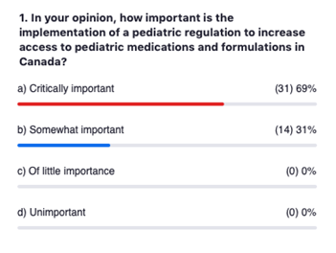
Polling Question 1 Results:

Slide 21
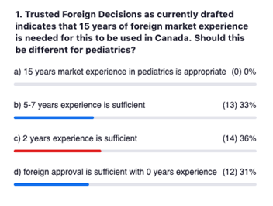
Polling Question 2 Results:

Slide 22
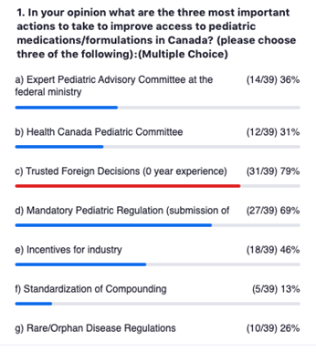
Polling Question 3 Results:

Slide 23
Questions for Health Canada
The CCA report was published in 2014 and many of the recommendations in the PDAP were presented at that time. When will the OPPI present clear objectives, with metric and targets?
What is the budget for this initiative and how many resources will be dedicated to PDAP?
Recognizing that HC has internal priorities – how can the pediatric community support HC?
How will the decision be made to formalize pediatric expertise at:
EPAB at the Federal Ministry of Health
Health Canada Pediatric Committee
What approaches are possible for HC to contribute to providing incentives to industry?
How will the PDAP framework will address old off-patent drugs?
CONFIDENTIAL

Slide 24
Top 3 Most Important Actions
Based on the polling questions during the workshop the following three were cited as the top most important actions.
Institute Trusted Foreign Decisions 79%
Mandatory Pediatric Regulation 69%
using submissions “as is” from other countries
Incentives for commercialization 46%
in Canada both brand and off-patent medications

Slide 25
Overall Health Canada’s PDAP Responds to Many of the Needs Identified by Stakeholders
The pediatric community looks forward to continuing to support Health Canada in its objectives to bolster pediatric submissions in Canada.
Thank you for the opportunity for the pediatric community to provide Health Canada with feedback to the PDAP.

